Slide 1
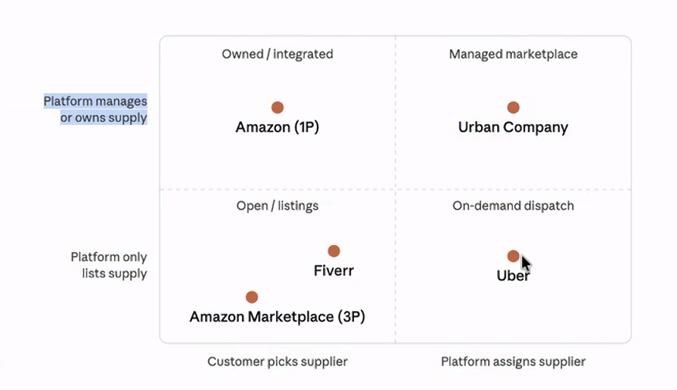

Slide 2
Marketplace
What does it mean to OWN & MANAGE the supply?
What does it mean to CERTIFY the supply?
Demand refers to who exactly?
Who OWNS & MANAGES the supply?
Who CERTIFIES the supply?
Who can be part of the Demand pool?

Slide 3
What do the caregivers need respite for?
Take my elderly to the clinic
Play mahjong / entertain the elderly for 1-2 hours
Fetch food from the condo gate
Household chores
Enjoy lunch together

Slide 4
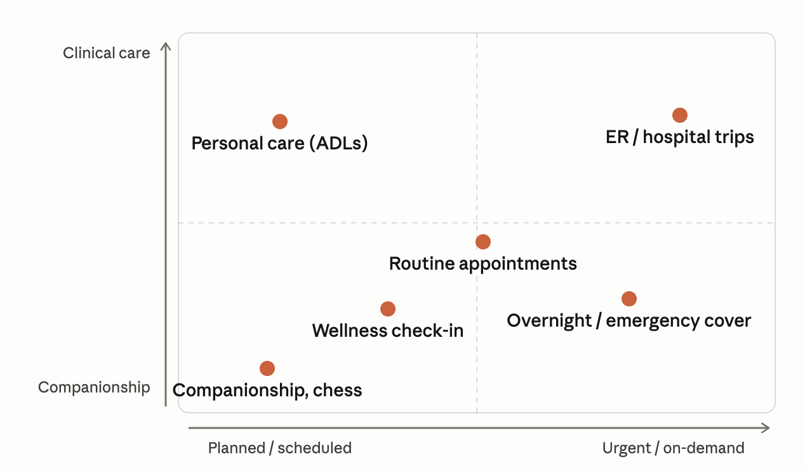
What do the caregivers need respite for?
By task (low touch → clinical):
Companionship & engagement — Conversation and company to fight isolation, games/hobbies (chess, cards, puzzles), reading, music, reminiscence, accompanied walks and outings (park, café, place of worship), and cognitive stimulation that matters a lot in early dementia.
Wellness checks & supervision — A drop-in to confirm they've eaten, taken meds, and are safe and okay; fall-risk and mobility supervision; dementia wandering/sundowning watch; overnight supervision; and lightweight video check-ins between in-person visits.
Medical accompaniment & coordination — Transport to and company at the ER/urgent care, routine doctor and specialist visits, and recurring treatments (dialysis, physio, chemo, dental); post-discharge supervision. Plus the under-appreciated coordination layer: taking notes at appointments, relaying instructions back to the family, reconciling medications, prompting or administering meds where qualified.
Personal care (ADLs) — Bathing, dressing, grooming, toileting, feeding, transfers, continence care. This needs a trained aide, not a companion.
Household & errands (IADLs) — meal prep, light housekeeping and laundry, grocery and pharmacy runs, bill help, and transport to errands or social events.
Specialized respite — dementia/Alzheimer's-trained cover, palliative/hospice respite, and skilled nursing tasks (wound care, injections, vitals) at the nurse level.

Slide 5
Intro of solution we’re thinking about
[CRAZY VER]
A marketplace app that will deploy Humanoid or Pet Robot for the elderly who is in need of a companion, while family members will get a live updates. These Humanoids will conduct health research to delay ageing of the elderly it’s dealing with.
[LESS CRAZY VER]
A marketplace app that … Records what and how respite caregivers perform their real world duty - these datapoints can be shared/sold to model providers to learn how to do daily tasks. Subsequently we can use the trained data to develop humanoids and increase the supply of volunteers. (link)

Slide 6
Questions we want to ask (Vanguard)
How big is the respite caregiver problem?
Across all 4 SCC, 160 clients daily
Chaperone appointments 20-30/month
3 days notice in advance
Supply
3-4 staff per center (salary/month)
19-20 micro-jobbers per center ($10-12/hour)
Charge to clients ($25-35/hour)
Diff is the operational cost
What is the biggest use case? What do the caregivers need respite for?
Not just medical, can include haircut, getting discharged, (social aspects) etc.
Challenge of changing people’s Mindset?!
Do we have any survey data that provides this is a problem worth solving?
MET (Medical xx Transport)
AIC (sector level assessor)
Problems range
Chaperone
Night shift
Custodian
Eldercare is unpredictable, only comes to mind only when it happens
Caregiver planning ahead
Care services
Help seeking behaviours, Tech that needs to be ready for the next set of rising issues
Seniors staying with seniors
Domestic helpers running away
When one passes away, falling into grief
Staying alone, without children, not married, etc. diff profiles leading to diff scenarios
If we were to create a supply and demand app →
does this make sense on the ground? Will it be useful?
Will be solve your actual problems?
Is this needed?
Is this feasible? Is there a market for it?

Slide 7
Questions we want to ask (Vanguard)
If we were to create a supply and demand app; then
What does it mean to CERTIFY the supply?
Can they be trained? Can people sign up?
Who CERTIFIES the supply?
Vanguard is doing an in-house training
Micro-jobs’ job scopes are clearly defined
Competency is evaluated
Is Vanguard ok to use a certified helper from somewhere else, and for their certified helper to be allocated elsewhere?
Is there an underutilized pool of caregivers at Vanguard?
DEMAND refers to who exactly?
Who can be part of the demand pool? Where does this come from?
E.g. Who can we target, e.g. active ageing centers, neighbourhoods etc?
Who OWNS & MANAGES the SUPPLY?
Where does this supply come from, e.g. volunteers, paid work etc.
How are the people trained for these micro jobs in this senior care setting?
Half day training, OJT
How does Vanguard assess micro-worker readiness for dementia care?
What barriers exist to formalising gig-workers for respite care?

Slide 8
Questions we want to ask (Vanguard)
[Matching control] Do we want the customer to pick the specific supplier, or does the platform assign one?
(Amazon lets you choose a seller; Uber hands you a driver.)
[Management/integration depth] How much the platform vets, trains, prices, standardizes, supplies tools to, or even owns the supply.
How / where does it work?
Integrate into what?
Ask from Vanguard/NCSS:
How can we make this more real with your help? Channels you can take this to? Bringing your supply? MoU signed - who is the counterparty - SGLN tech?
How can we partner on this? NCSS specifically? Vanguard specifically?

Slide 9
Next Steps
AIC
Care Corner
Vanguard
Share the job scopes that are being listed out under Volunteers
Share the next steps/plan for the existing pilot in Pasir Ris + other locations
NCSS
Connect us to AIC --
To get data points on national/sector-level to quantify/validate the “hidden demand”
To do training
Care Corner
SGLN Tech
Defining the problem
National-level solutioning

Slide 10
Vanguard Team Meeting
Jasmine
Angeline
Jason
Michelle
Chermaine
Wei Lin
Abhishek
Shobhit
Lara
Aditi

Slide 11
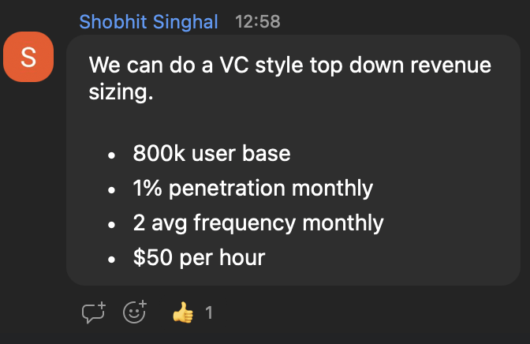

Slide 12
Grab Interviews w 14 Seniors
elderly interviews
Some takeaways from the 14 interviews done yesterday at Marsiling Active Ageing Centre:
Demographics
5 active seniors; 5 partially dependent seniors (PDS); 3 primary caregivers of PDS; 1 secondary caregiver of PDS
All participants were in their late 70s or 80s
Observations
Most participants did not know how to book ride-hailing services. More than half had a smartphone but used it only for calling and texting. They were hesitant to use Grab because it is unfamiliar and they worry about scams or making mistakes when transacting on their phones.
Bus/MRT was the predominant mode of transport. Many avoided taxis because they are willing to trade time for money and perceive taxis as expensive, preferring not to spend on themselves unless necessary. One caregiver and one active senior reported using Grab fairly often, mainly for longer trips (e.g., Marsiling to SGH or Redhill).
When they did take taxis, they typically either flagged one down or asked family or centre staff to book for them, and they paid in cash.
One active senior used social media apps (TikTok, Instagram, Facebook) but did not want to transact on Shopee/Grab due to fear of scams.
Some seniors could not read written Mandarin well, and a few mentioned eyesight issues.
AAC shared that approximately 2,000 older adults live in the area; 1,200 are registered with the centre; and about 300 regularly visit for activities.
Takeaways
It is unlikely this segment will adopt taxis/ride-hailing as their primary transport mode as long as they can manage taking the bus/MRT.
There is a strong use case for medical trips between home and healthcare institutions.
There is a moderate use case for caregivers booking taxis to transport fully dependent seniors.
Caregivers may be more willing to spend on ride-hailing/food delivery for the seniors in their care (observed in two cases; needs validation with a larger sample).
Consider strengthening non-app booking channels (e.g., phone bookings, street-hail) to address digital and language barriers.
Seniors enjoy AAC activities and afternoon talks. Hosting engagement and digital/literacy sessions at AAC could be effective (noting potential selection bias).

Slide 13
Instructions for Jul 20
📌 Key Deliverables
1️⃣ Undertake a 1-hour Ideation Sprint ⏱️ 🔹 Generate 40 ideas — use images as much as possible 🖼️ and update them on Padlet 🔹 Converge on 1–3 ideas that you will move to prototype 🛠️
🗓️ 20 July Session You'll be sharing your ideation journey — diverging 💡 then converging 🎯 — into the ideas to prototype.
Teams will be divided into 3 groups, and each team will have 12-15 mins to share findings with your peers.
Teams can start building your prototypes which will be presented at the 🗓️ August 20th session.
🙋 Optional: Team Feedback Session
Any team requiring feedback — I'm happy to provide a 30 min session 🕐. Just ping me directly and we'll sort out timings
Let's design for impact! 💪✨

Slide 14
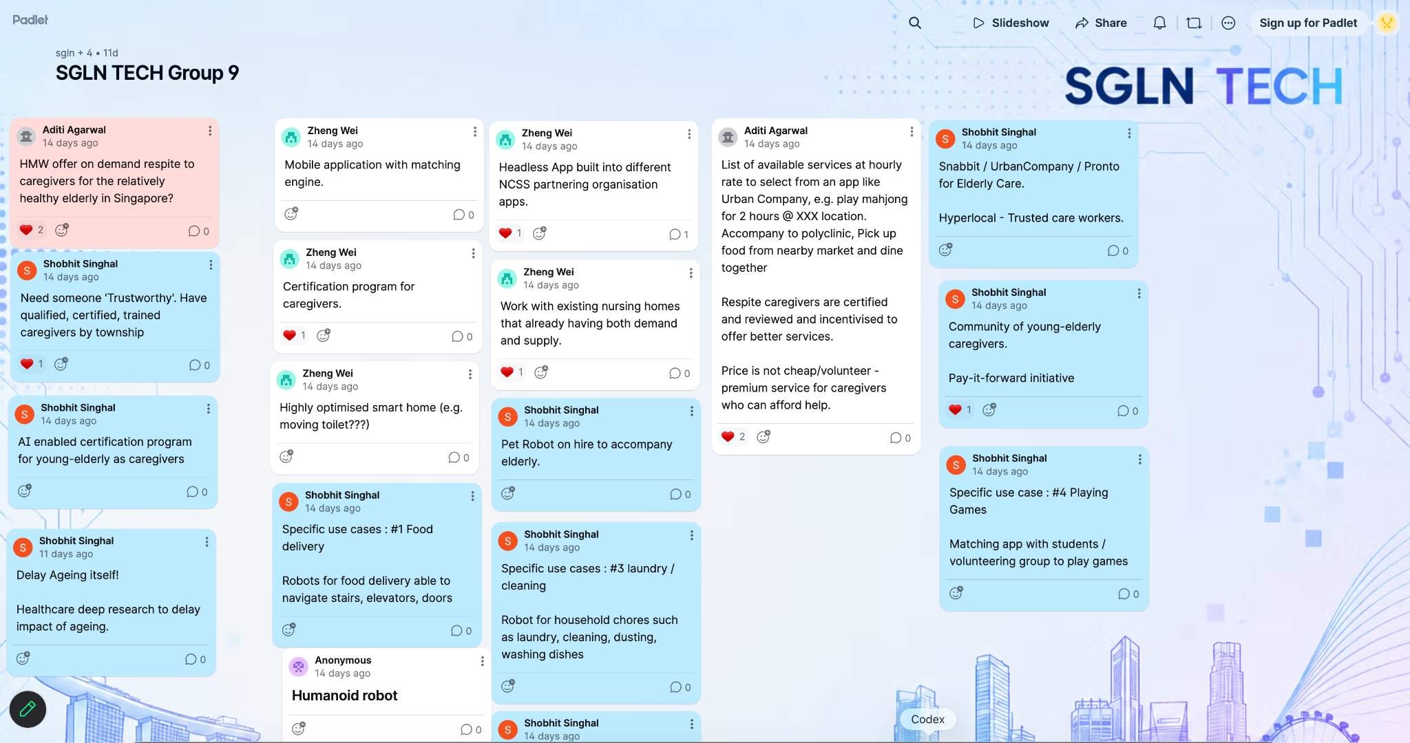
https://padlet.com/SGLNTeam/sgln-tech-group-9-og0dc3wm80czqako

Slide 15
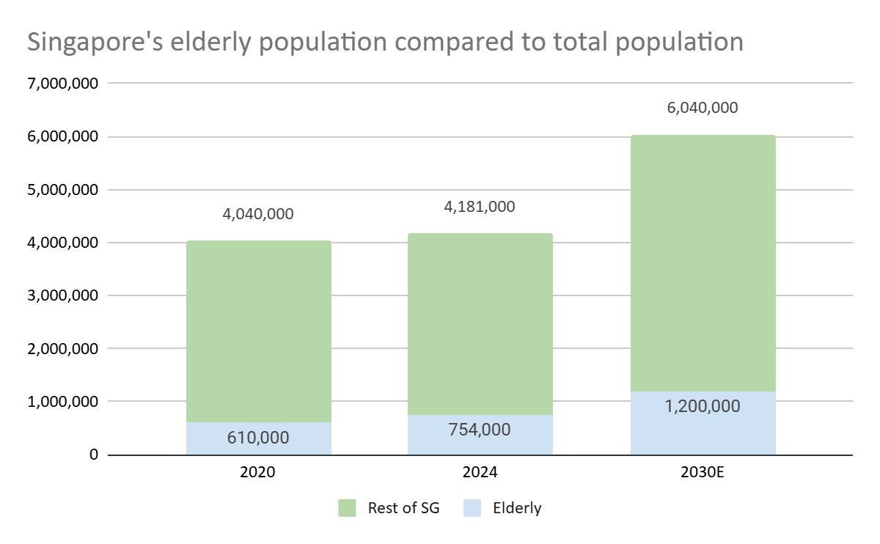



There is a growing elderly population in Singapore with adapting needs that Grab could address, signalling strong growth in the eldercare market
Number of elderly¹ and their proportion to the total population are both increasing rapidly
Recent government eldercare initiatives to address these needs:
1
Age Well SG
Dedicate $3.5 Bn over next decade to encourage active living and expand Active Ageing Centres from 154 to >223 by 2025
2
Enhanced Long-Term Care Subsidies & Grants
Dedicate $300 Mn to ease access to home and community-based care
3
Senior’s Mobility and Enabling Fund
Changing elderly needs:
Dedicate ~$50 Mn annually over next 5 years to maintain senior’s mobility by supporting subsidies for mobility aids
Increasing healthcare and long-term care needs as Singapore reaches ‘super-aged’ status from 2026 (>20% of total population consists of elderly)
Need for social connectivity and active ageing
Changing family norms (e.g., shrinking family units, some seniors preferring to live independently)
¹Elderly refers to seniors aged 65 years or older
Source: Singapore Department of Statistics Singapore residents data, Singapore Budget 2023-2025, Ministry of Health

Slide 16






Customer/user segments for eldercare in Singapore
Independent Seniors*
Partially Dependent Seniors*
Fully Dependent Seniors*
>800,000¹
~39,000²
~44,000²
~83,000¹ living alone
Seniors who can perform all ADLs** independently without assistance (i.e. no ADLs).
Seniors who cannot live independently (i.e., need assistance for 1-2 ADLs**) but are not too ill to be cared for in nursing homes.
Seniors who requires assistance for most or nearly all ADLs** (i.e., need assistance with >= 3 ADLs).
Primary (Informal) Caregivers
Professional Caregivers/Helpers
Respite/Interim Caregivers
>12,400³
>27,000^{3,4,5}
>2,400⁶
The main person responsible for providing day-to-day care to an elderly or person with disabilities, typically a family member.
A trained and often certified care worker employed to deliver care services on a paid basis, either at home or in a facility.
A temporary caregiver (professional or volunteer) engaged to provide relief when the primary caregiver is unavailable on a short-term basis.
Legend:
Sources: ¹YCP, ²Duke-NUS, ³MOH, ⁴The Straits Times, ⁵CNA, ⁶CNA, ⁷BMC Geriatrics
*Based on 2030 Projections
**Commonly assessed based on Katz Index of Independence in Activities of Daily Living (ADL)⁷: Key daily tasks include Bathing, Dressing, Toileting, Transferring, Continence, and Feeding
In scope
Out of scope
Notes:
Key Data Points from NCSS:
Positive Sentiments: 63% of seniors agree that digital technologies make life easier, and 45% are willing to try new technologies. However, only 24% know how to use emerging technologies like voice recognition or augmented reality. Grab can offer user-friendly tech solutions tailored for seniors.
Concerns About Risks: Seniors are cautious about online scams and misinformation. Building trust through secure platforms and scam-prevention education will be critical.
"Digital First, Not Digital Only": While digital adoption is growing, essential services must remain accessible via non-digital channels. Grab can offer hybrid solutions combining app-based and offline services.
Online Transactions: Seniors' use of online payments has doubled from 38% in 2018 to 78% in 2022. This suggests an increasing willingness to adopt digital payment methods, but trust and confidence in such transactions need reinforcement.
Singpass App Usage: 67% of seniors used Singpass in 2022, up from 41% in 2020. This indicates familiarity with government-backed apps, which can be a trust-building factor for Grab's digital services.
Smartphone Ownership: 89% of seniors own smartphones, showing a significant increase from 74% in 2017. This indicates growing comfort with mobile devices, which can be leveraged for app-based services.
Only 46% of Seniors keep their smartphones up to date
Info dump:
Singapore anticipates a rising number of seniors requiring support: by 2030, approx. 100,000 will need help with at least one ADL, and about 83,000 will be living alone.
About 100,000 seniors in Singapore will require help with at least one activity of daily living (ADL) by 2030 (CNBC)
Nearly 83,000 seniors are projected to be living alone by 2030
Cargivers (210,000 total – inclusive of all types of caregivers)
Primary
Professional
In 2017, about 8,300 staff were providing direct care in long-term care (LTC) settings such as nursing homes and home- or centre-based services (MOH)
The broader community care workforce, including nurses, allied health professionals, and support staff, grew from 16,500 (2020) to over 18,000 by 2024 (The Straits Times)
As of recently, there are about 1,600 live-in professional caregivers in Singapore, more than double the 700 in 2018 (CNA, Demand for professional caregiving help for the elderly on the rise).
Respite / Interim

Slide 17
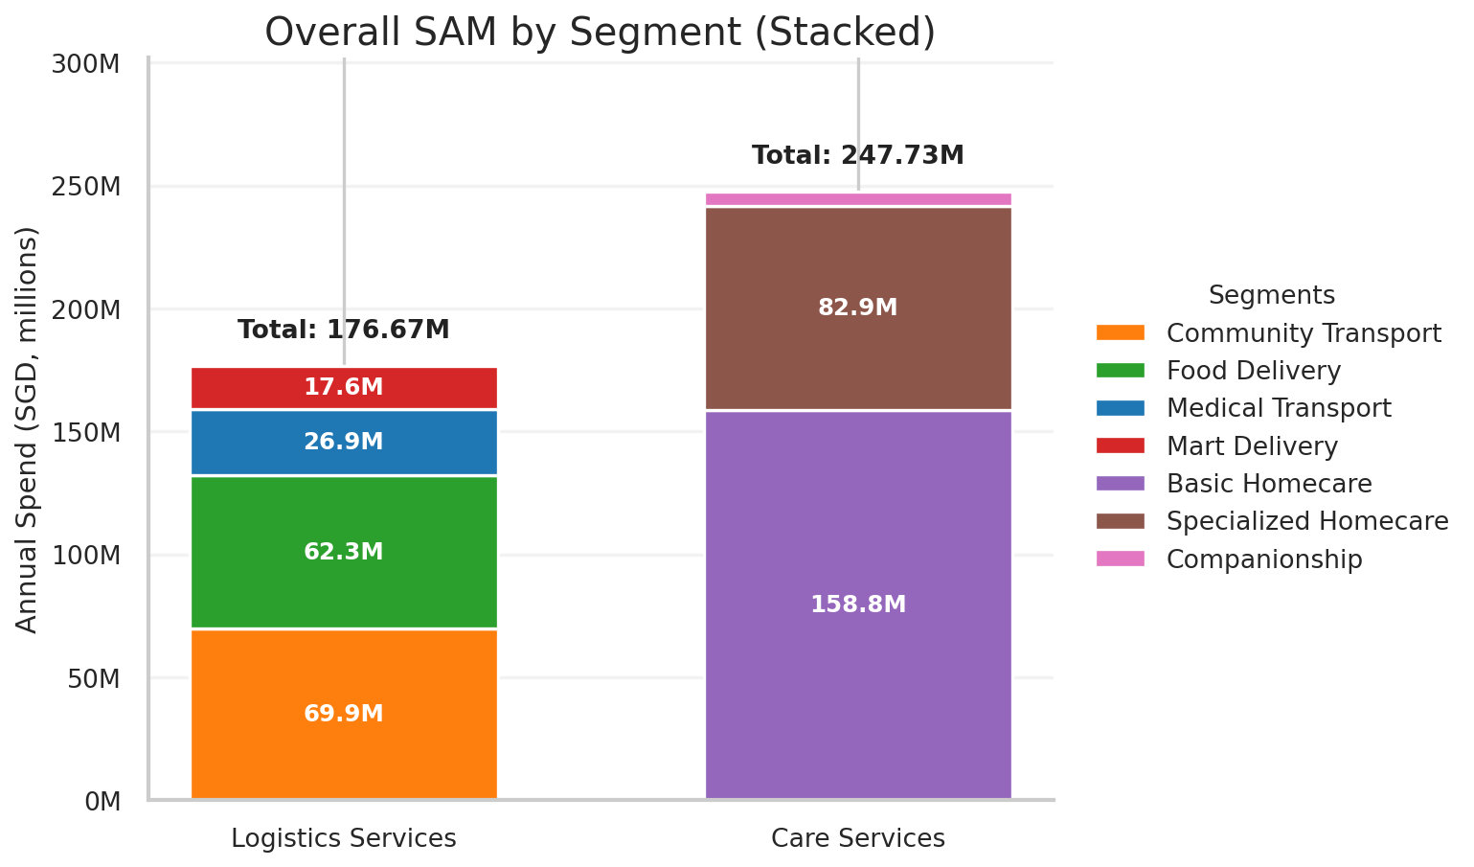
Today, there is a ~$425 Mn addressable market opportunity in Singapore that Grab can tap into, to grow our core offerings and expand into new services
Key Takeaways:
Elderly demographic growing at ~9.75% CAGR over 5 years
Medical and non-medical services must rapidly scale in the next 5 years to meet demand
Elderly to soon represent 20-25% of Singapore’s population — a significant market opportunity
Grab must adapt mobility and food services to capture this growing market
Methodology:
No of users
Frequency of Purchase
Avg Spend per Purchase
Calculated based on demographic data
Focus on high usage customers most relevant to each service
Modelled based on estimated usage of each service (Pending validation with customer interviews)
Grab historical AOVs
AIC budgets per trip
Competitor pricing
Note: SAM refers to serviceable addressable market, which refers to the portion of the Total Addressable Market that Grab can realistically target and serve
Sources: SingStat Seniors Living Arrangements (2024); SingStat Census 2020: Difficulty in Basic Activities; IMDA Singapore Digital Society Report (2023); Ask.gov.sg HealthierSG – Medical consultation frequency ; Homage Singapore – Home care pricing benchmarks; CNA Big Read – Ageing population & care needs; Straits Times – Duke-NUS informal caregiving economic value study

Slide 18
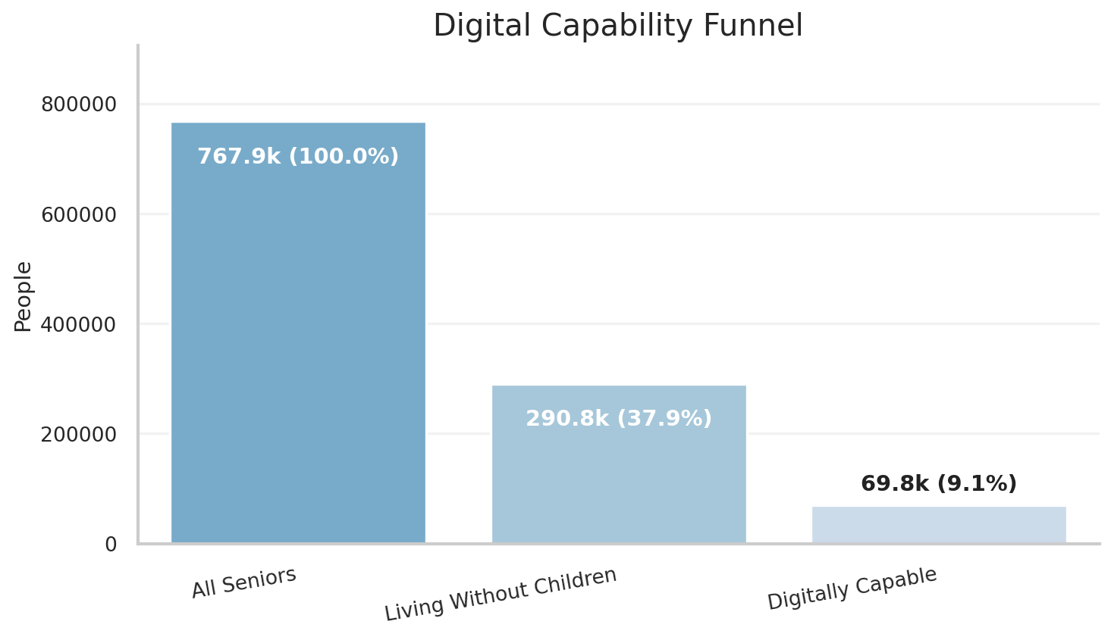
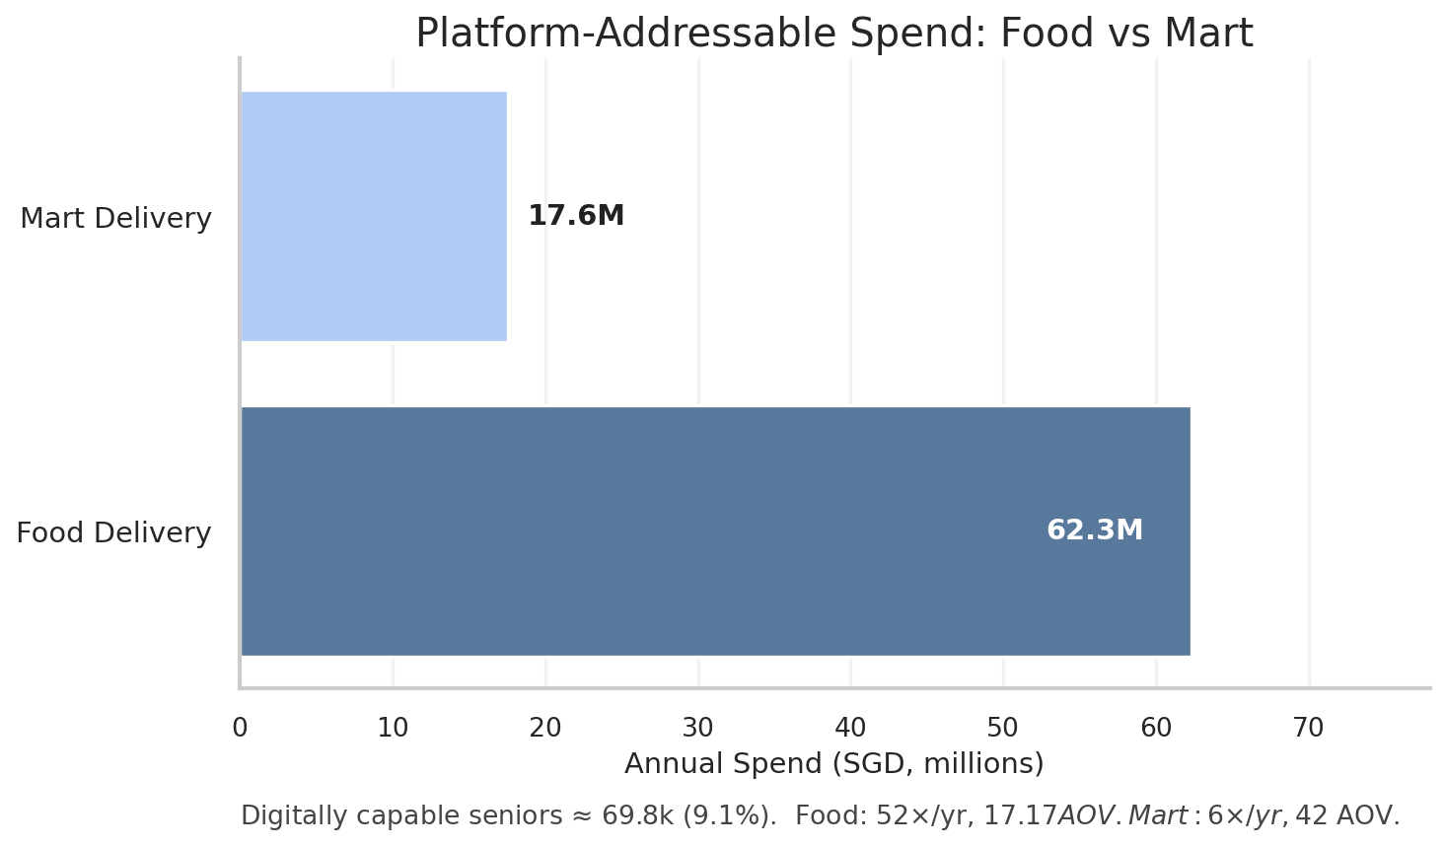
290,800 seniors live without their children and could be supported through our food and mart services but digital literacy will remain a barrier
Key Assumptions | Explanation/Drivers
Seniors living without children as target demographic (Base = 290.8k) | This represents the total number of seniors living without children who can be empowered by Grab’s services
Digitally Capable (Base = 24%) | Will increase naturally overtime, 24% is the current group of seniors comfortable with using emerging technologies
Food Delivery Freq (Base = 52 orders per year) | Assumes 1 delivery per week, customer behaviour to be validated during discovery
Mart Delivery Freq (Base = 6 orders per year) | Assumes 1 delivery every other month, could be driven by auto-restocks and focus mostly on bulky and heavy items that are more difficult for seniors to carry
Sources: SingStat Seniors Living Arrangements (2024); SingStat Census 2020: IMDA Singapore Digital Society Report (2023)

Slide 19
Brainstorm on NAME
“Respite Care Resources” <=====> “Respite Care Market”
Care-pilot
Caregiver co-pilot
Open-care
Respite carer
Caregiver co-work
C-3PO
Care Partner Lah !!
TemanLah

Slide 20
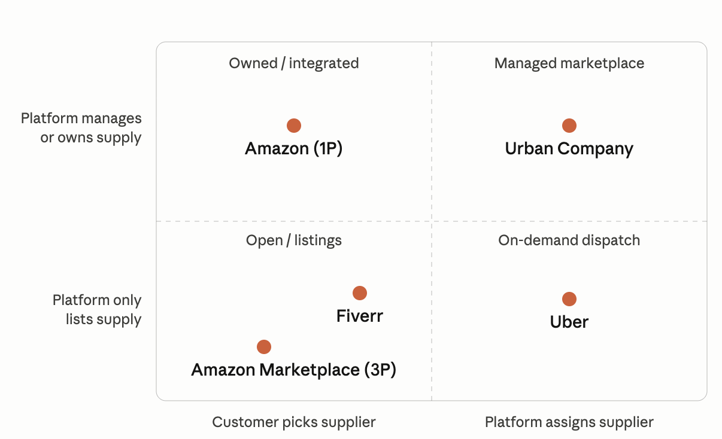
How much control the platform takes over the supply side
Matching control — does the customer pick the specific supplier, or does the platform assign one? (Amazon lets you choose a seller; Uber hands you a driver.)
Management/integration depth — how much the platform vets, trains, prices, standardizes, supplies tools to, or even owns the supply.
1. Open / listings marketplace (lowest control) — supply self-onboards, sets its own prices, and the customer browses and picks. The platform is essentially a directory plus trust, payments, and reviews. Supply is differentiated (one product/seller isn't interchangeable with another), so the buyer has to choose. → Amazon Marketplace (3P), eBay, Etsy.
2. Curated / freelance marketplace (low–medium) — same demand-led matching (buyer still picks), but the platform shapes how supply is packaged: standardized "gigs," profiles, ratings, escrow, light vetting. → Fiverr, Upwork, Airbnb. Fiverr sits a notch above Upwork because it forces sellers into productized gig formats.
3. On-demand dispatch (medium–high — control over matching) — the defining shift: the customer no longer picks. Because supply is fungible/commoditized (one ride ≈ another), the platform can algorithmically assign a supplier and set the price (including surge). It still vets but stays asset-light — drivers own the cars and are independent. → Uber, Lyft, DoorDash.
4. Managed marketplace (high) — platform-led matching plus deep management. It vets and trains providers, sets the price, defines the service protocol and quality standards, and often supplies the materials/tools. The supplier becomes almost a controlled extension of the platform without being employed by it. → Urban Company (UrbanClap), and parts of Thumbtack/Instacart.
5. Owned / integrated (highest) — the platform owns the inventory or employs the providers outright. At this point it stops being a true marketplace and becomes a vertically integrated retailer/operator. → Amazon Retail (1P/FBA), cloud kitchens (Rebel Foods), Oyo's managed inventory.

